Slide 1
Multi-tier Optimization of 5G Heterogeneous Networks
Three Major Goals of the Proposal
Network Throughput Optimization
Secrecy and Secure Routing
Network Reliability and Failure Recovery

Slide 2
Questions to ETTUS
We want to build testbed to simulate/emulate 5G network. Can we do this? If not, what can we implement partially? What can't we implement?
What configuration and setup do you recommend for the testbed?
Can we implement/program MAC layer functionalities? If so how?
Can we alter/program PHY layer? If so how?
Do you have any relevant white papers or case studies?
Can we "program" or simulate any security attacks?
There are two products-- FPGA based and SoC based. What are the differences and which one is recommended for our purpose?
We would to measure throughput and reliability of the network. What tools can we use for this purpose?
Waveform generators -- is waveform generation in built or can be customize it by programming
Can we do power analysis of transmission algorithms? (FPGA power)?
Can we do jitter analysis?
Will it support antenna with 100+ m range.
Internal purposes
Do we have a channel noise generator? Dr. Arslan's lab has it (according to Thomas)

Slide 3
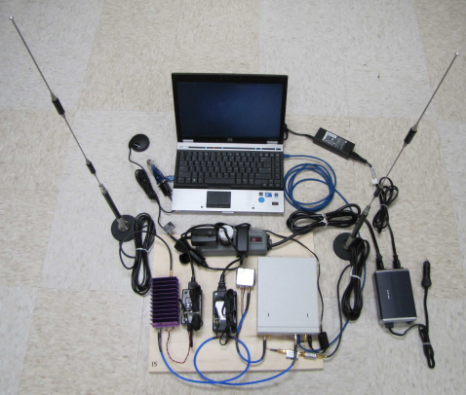
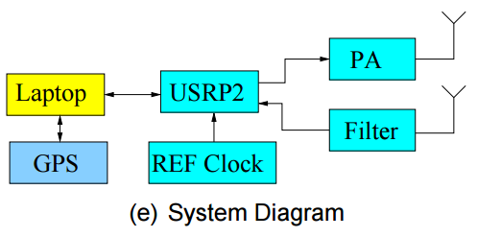
Picture taken from http://gnuradio.org/data/grcon11/02-ge-gr_network_layer.pdf

Slide 4
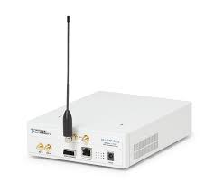
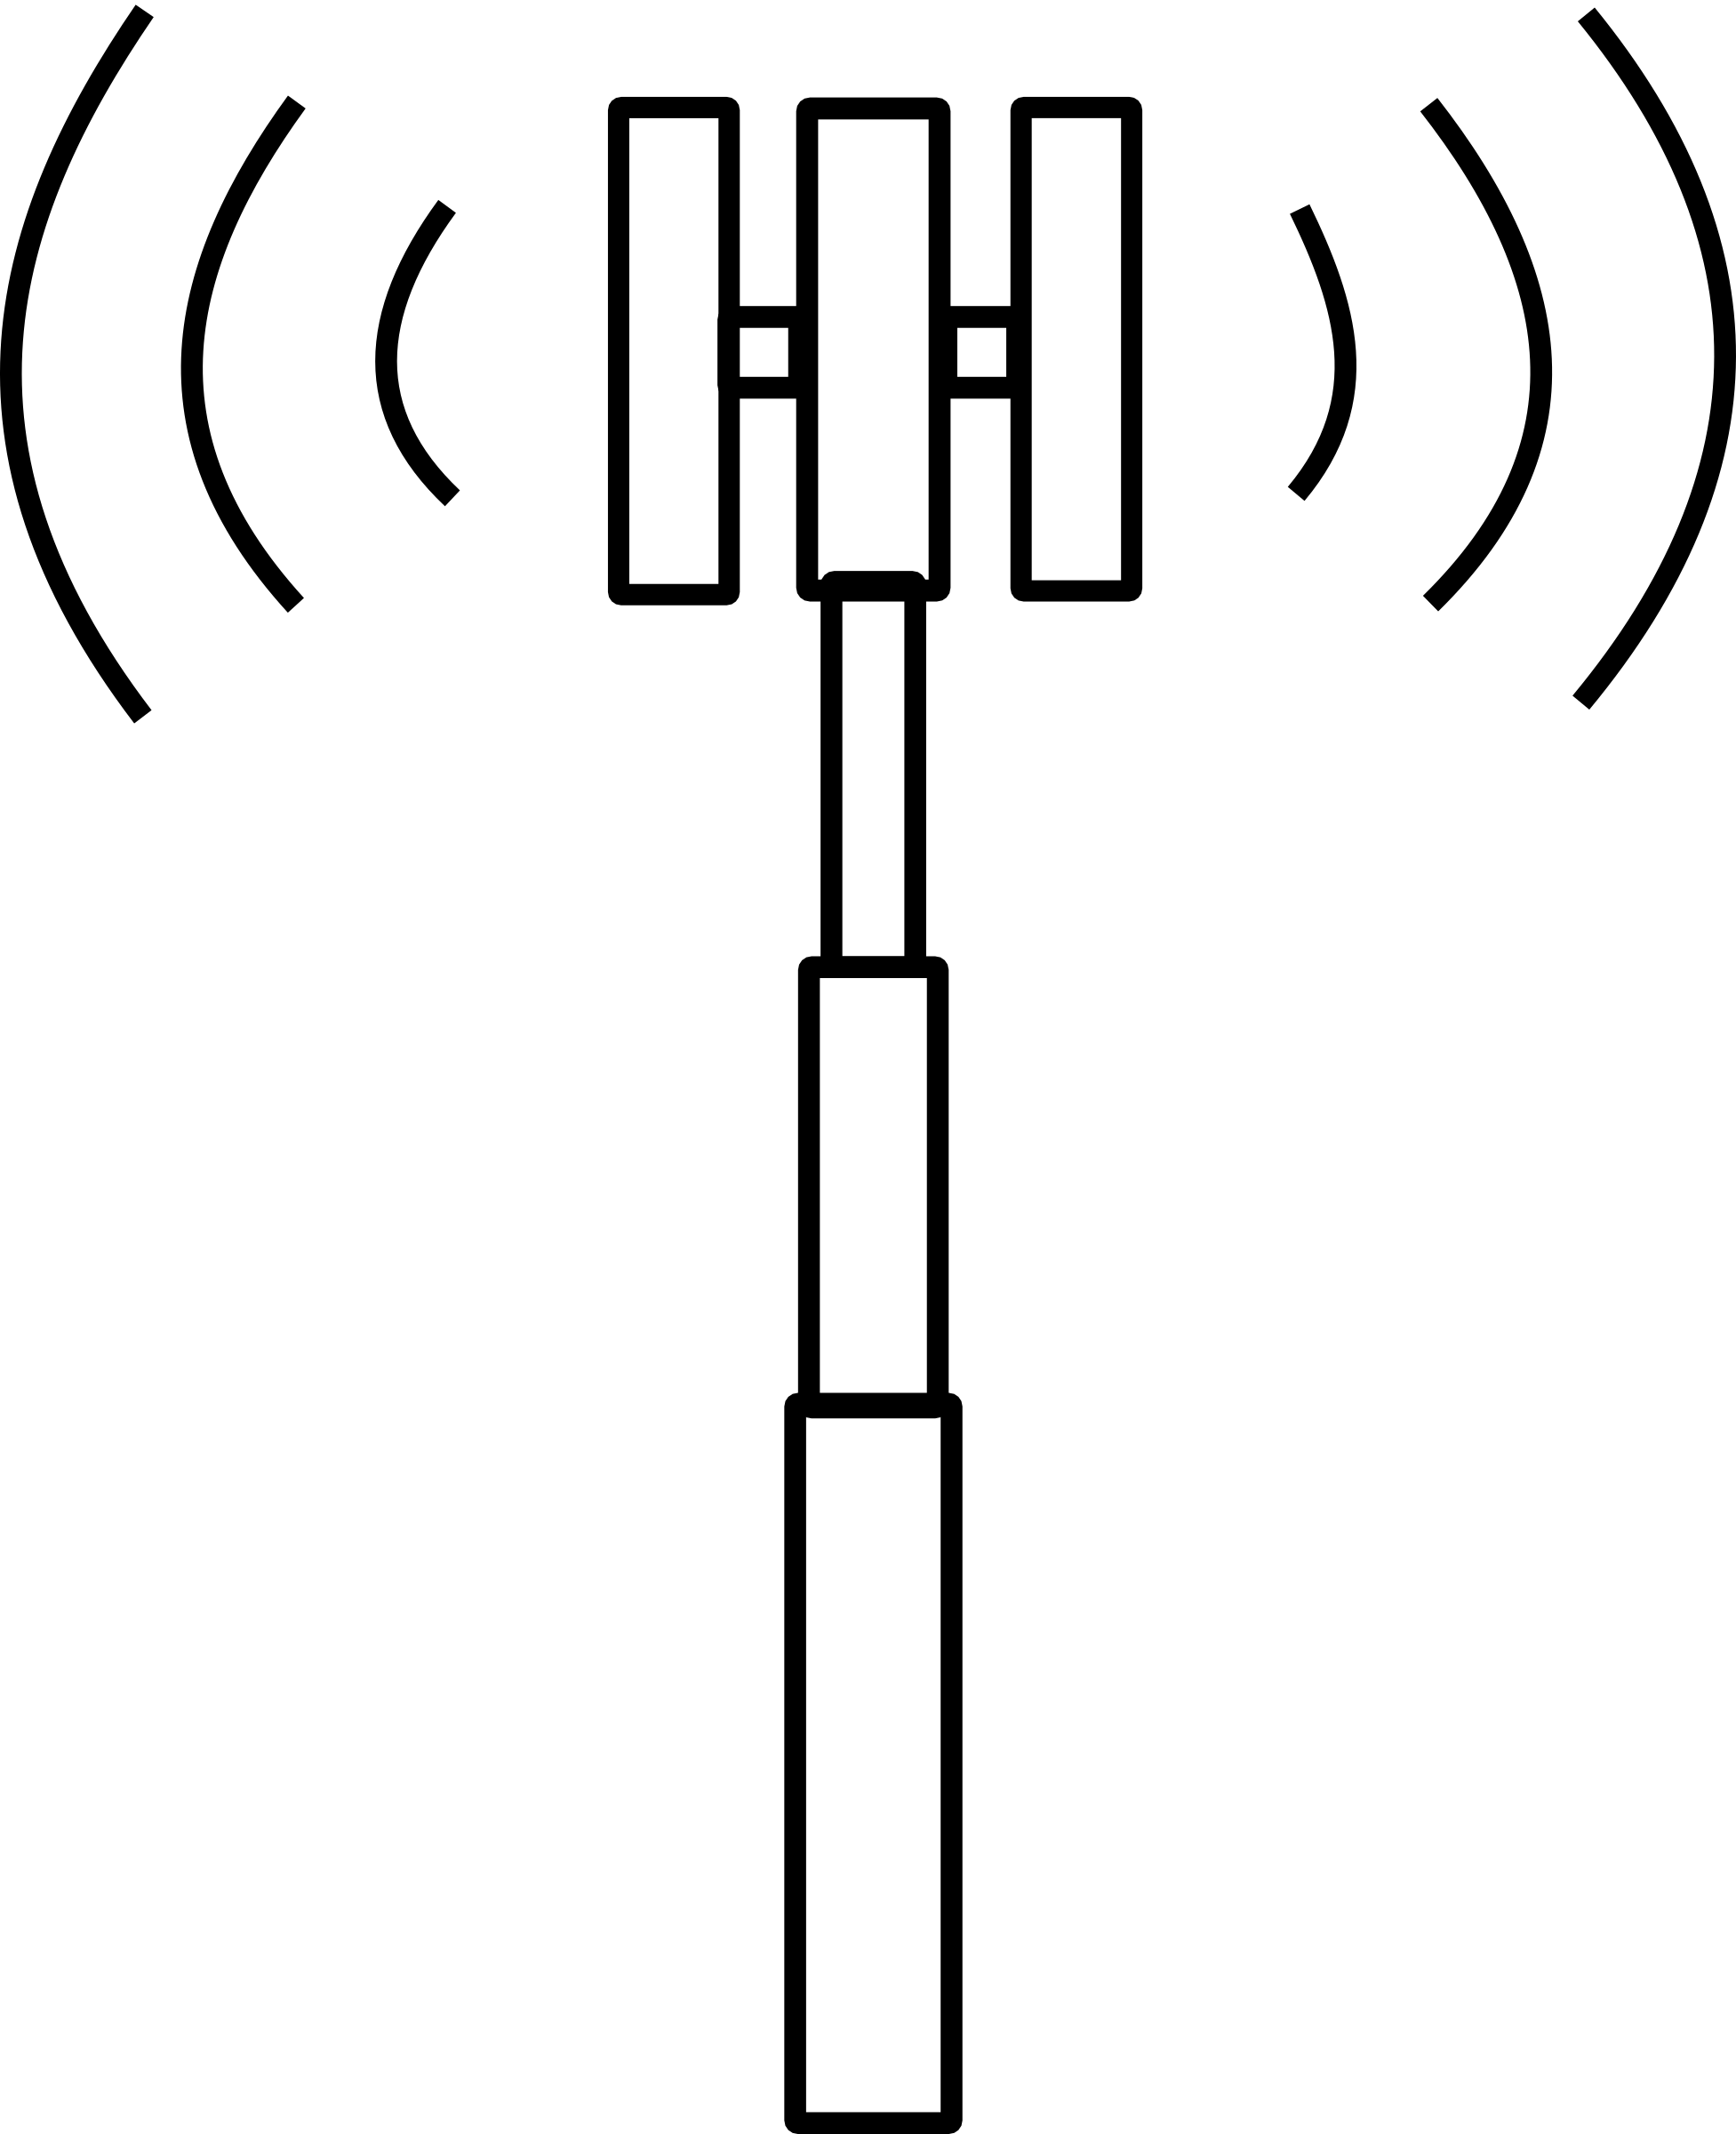


Network Throughput Optimization in 5G
Scenario 1a: D2D Communication (Indoor Setting)
Mode Selection Problem
Should UE relay another UE’s tranmissions in UL or DL?
What incentive he has?
door
BS
UE1
room
UE2
Lab Test Environment
Testing the conditions when UE1 need to relay for UE2
Channel conditions
Interference conditions
Power budget
Incentives (Scheduling)
Game theory and coalitions
5G Cellular Networks
Dual-mode UE can relay if there is an incentive

Slide 5
Network Throughput Optimization in 5G
Scenario 1b: D2D Communication (Outdoor Setting)
Lightweight Distributed Algorithms for Relay Selection
UE1 and BS are spatially separated by a building
There are multiple UEs that can relay
We need fast and distributed algorithms for the optimum network performance
BS
UE3
UE1
UE2

Slide 6
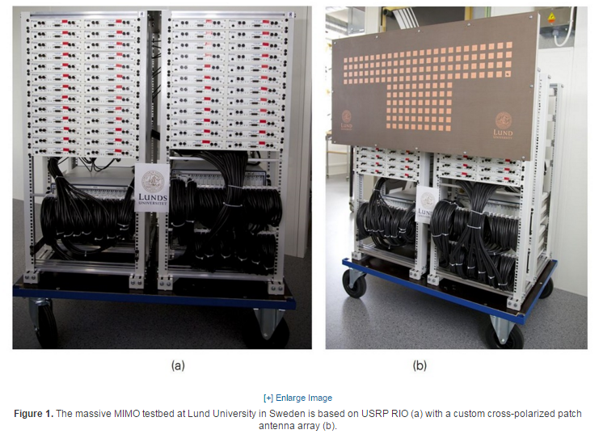
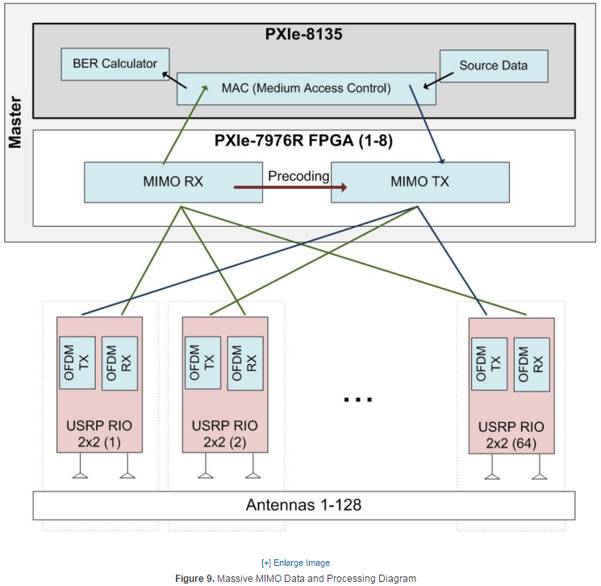
Massive MIMO prototype at Lund University
Whitepaper
http://www.ni.com/white-paper/52382/en/?cid=Social-Company-Corporate-sf29667469
Equipment
64 USRP RIO (Each contributing 2 antennas to make 128 antennas overall)
PXIe-7976R FPGA(http://sine.ni.com/nips/cds/view/p/lang/en/nid/212692)
PXIe-8135 (http://sine.ni.com/nips/cds/view/p/lang/en/nid/210545)

